Slide 1
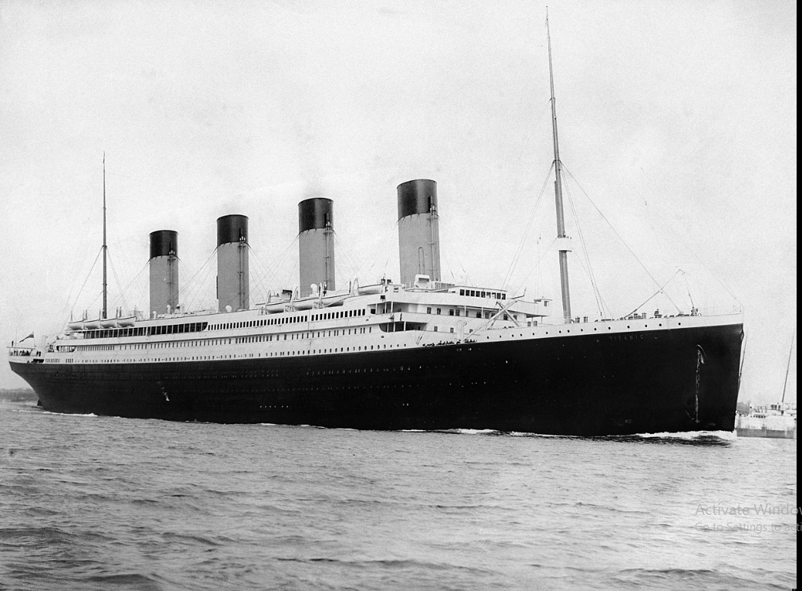
TITANIC
For the Titanic, Predict the person is survived or not.
Survived is derive from their entire details of the person.
Because we don’t know which type of persons are survived there.

Slide 2
Person is survived or not depend on
Passenger class
Sex
Age
Number of Siblings

Slide 3
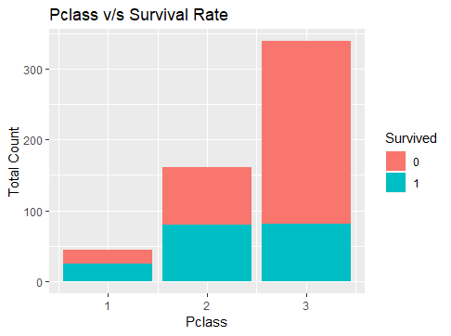
Passenger Class V/S Survival rate
Passenger Class | Rate of Surviving ( In Per)
1 | 56%
2 | 50%
3 | 23%
Person are more
save in class 1

Slide 4
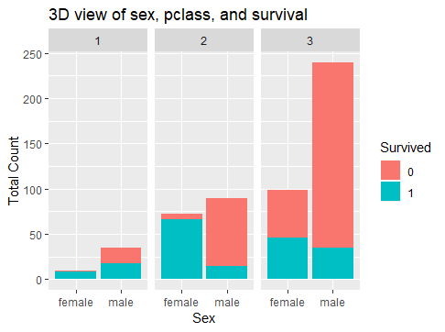
Passenger Class And Sex V/S Survival rate
Female are more save
in 1st and 2nd class
Male are save only in
1st class with 48%

Slide 5
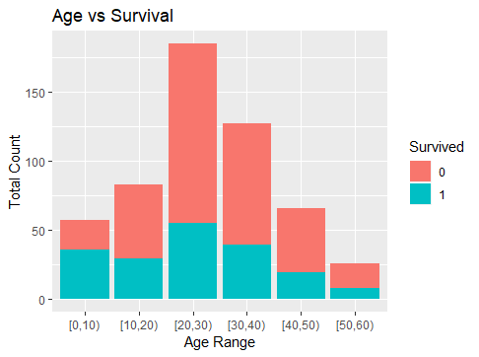
Age V/S Survival rate
Age Range | Rate of Surviving (In Per)
[0,10) | 63%
[10,20) | 35%
[20,30) | 30%
[30,40) | 31%
[40,50) | 29%
[50,60) | 31%
As Age increases, Surviving rate decreases
Children are save because of their parents
Old person are save by his experience

Slide 6
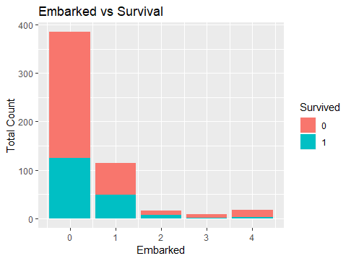
Number of Sibling V/S Survived
Number of Sibling | Rate of Surviving (In per)
0 | 32%
1 | 42%
2 | 41%
3 | 22%
4 | 16%
One and Two Sibling
person are more save

